Slide 1
MD5 Algorithm
Muhammad Naufal P.P
Ugi Ispoyo Widodo

Slide 2
What we Discuss?
Cryptyography, Encryption, MD5
MD5 Algorithm
How to works of MD5 Algorithm
Advantages and Disadvantages

Slide 3
Background
High human needs to the future require people to continue developing the technology owned. Human create solutions to overcome many problems, and now appears an algorithm used for security applications, one of them is MD5 algorithm.

Slide 4
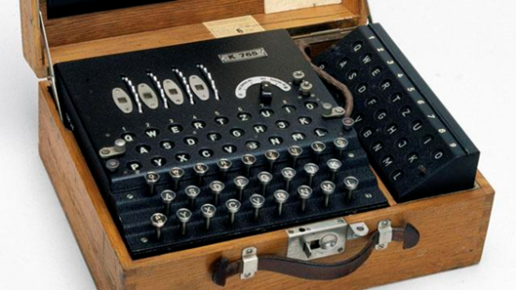
Definition of Cryptography
Cryptography is the conversion of data into a secret code for transmission over a public network.

Slide 5
Definition of Encryption
The process of encoding message that may it be read only by the sender and the intended recipient. Encryptions system often use two keys, a public keys, available to anyone, and a private key that allow only there recipient to decode the message

Slide 6
History of MD5 Algorithm
In 1990, Ron Rivest invented the hash function MD4.
In 1992, he improved on MD4 and developed another hash function: MD5.

Slide 7
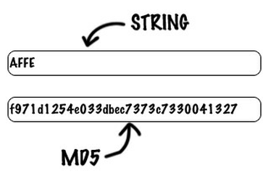
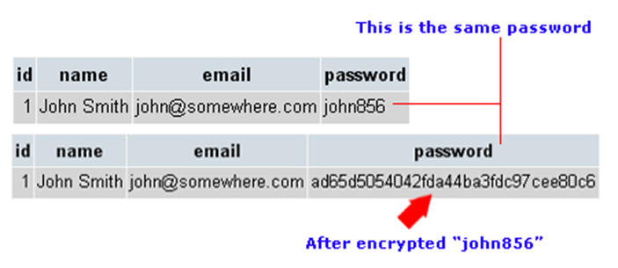
Definition of MD5 Algorithm

Slide 8
MD5 Algorithm
MD5 processes a variable length message into a fixed length output of 128 bits. The input message is broken up into chunks of 512 bit blocks.

Slide 9
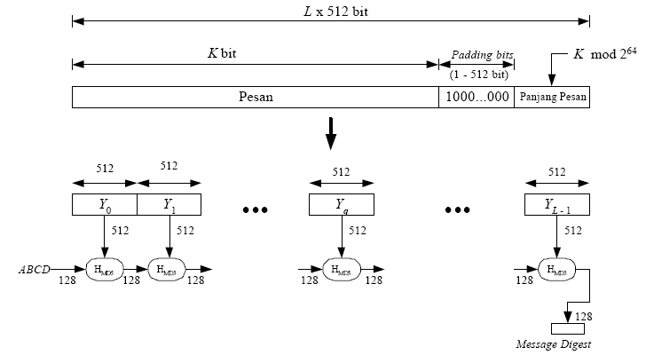
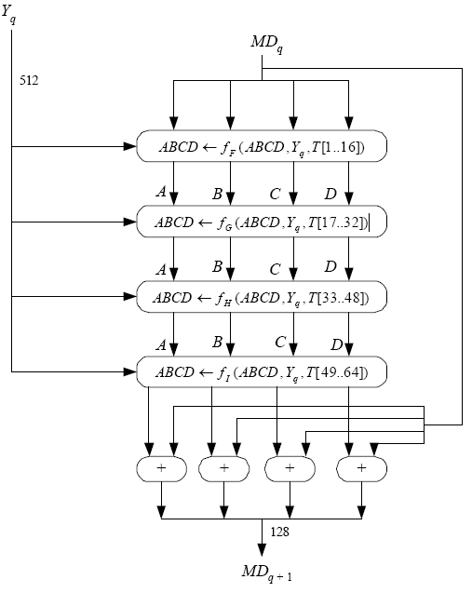
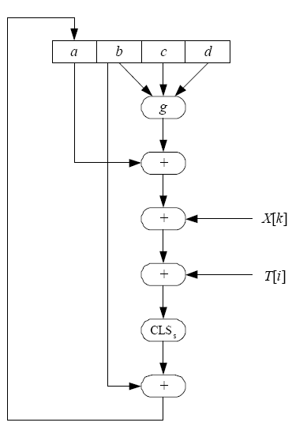
How to Work of MD5 Algorithm
Appending Padding Bits
Appending Length
Buffer Initialization
Processing of the Message
Output
The following diagram is a diagram of the whole process of the MD5 algorithm. The arrow diagrams explaining the smaller stages.

Slide 10
Step 1: Adding Bits
The first process is done is add a message with the number of bits booster so that the message length (in bits) is congruent to 448 modulo 512. This means that after adding bits booster, now the message length is 64 bits less than a multiple of 512. Things to remember is the number 512 appears because the MD5 algorithm to process messages in blocks 512.
If there is a message with a length of 448 bits, then the message will still be added with the bits of a booster. Messages will be added to 512 bits to 96 bits. So long bits wedge is between 1 and 512. Then another thing to note is that the bits booster consists of a binary 1 followed by the remaining bits 0.

Slide 11
Step 2: Appending Lenght
Then the next process is the message plus the 64 bits that specifies the length of the original message. If the message length is greater than 264 then it is taken modulo length in 264. In other words, if initially the message length equal to K bits, then 64 bits are added modulo 264. K stating that after the second process is completed, the length of the message now is 512 bits.

Slide 12
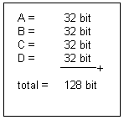
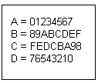
Step 3: Buffer Initialization
Then the next process is the message plus the 64 bits that specifies the length of the original message. If the message length is greater than 264 then it is taken modulo length in 264. In other words, if initially the message length equal to K bits, then 64 bits are added modulo 264. K stating that after the second process is completed, the length of the message now is 512 bits.
This buffer holds fourth intermediate results and final results. Each buffer is initialized with the values (in Hexadecimal notation) as follows:

Slide 13
Step 4: Processing of The Message
The next process is divided into L pieces of message blocks, each of which length is 512 bits (Y0 until YL-1). After that each block of 512 bits processed together with the MD buffer which produces a 128-bit output, and it is called HMD5. Here is an overview of the process HMD5

Slide 14
The next process is divided into L pieces of message blocks, each of which length is 512 bits (Y0 until YL-1). After that each block of 512 bits processed together with the MD buffer which produces a 128-bit output, and it is called HMD5. Here is an overview of the process HMD5
Processing of The Message

Slide 15
YQ declare blocks q 512-bit all of the messages that have been added with the bits of a booster in the first process and additional 64 bit length value of the original message in the process. MDQ is a 128 bit message digest value of the process HMD5 to-q. At the beginning of the process, an initial value buffer containing MDQ MD. Then the function fF, FG, FH, and fI in the picture, each containing 16 times the basic operations of the input, each of the basic operations using kn element T. The following table illustrated the basic operation MD5
Processing of The Message

Slide 16

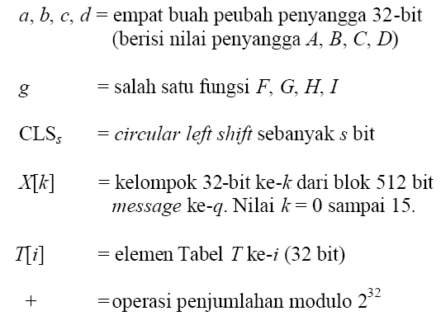
MD5 basic operations shown in the side image can be written with the following equation:
Processing of The Message

Slide 17
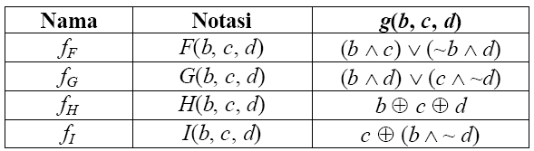
The function fF, FG, FH, and fI is a function to manipulate inputs a, b, c, and d with a 32-bit size. Each function can be seen in the table below
Processing of The Message

Slide 18
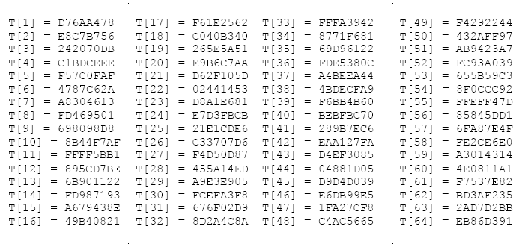
Then the value of T [i] can be seen in the table below. These are organized by function 232 x abs (sin (i)), i in radians.
Processing of The Message

Slide 19
table values T [i] of the treatment process 4

Slide 20

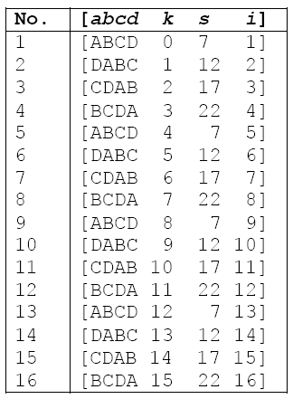
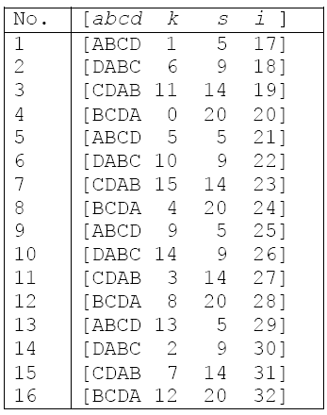
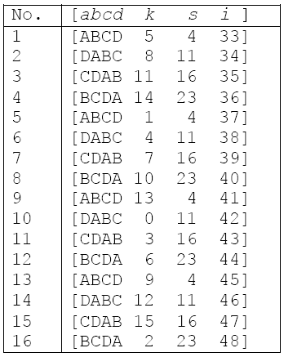
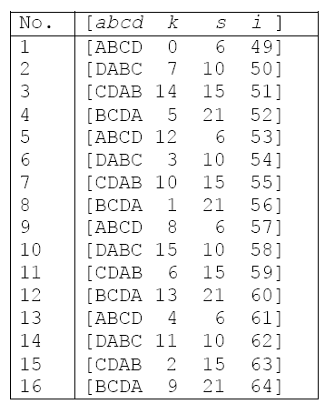
As previously explained that the function fF, FG, FH, and fI do 16 times the basic operations. Suppose the following notation,
stating operation for operation above, <<< s symbolize operation circular left shift of 32 bits, the basic operations on each lap can be tabulated as follows:
round 1
round 2
round 3
round 4
16 times the basic operations with g (b, c, d) - F (b, c, d), can be seen in the following table:
16 times the basic operations with g (b, c, d) - G (b, c, d), can be seen in the following table:
16 times the basic operations with g (b, c, d) - I (b, c, d), can be seen in the following table:
16 times the basic operations with g (b, c, d) - H (b, c, d), can be seen in the following table:
Processing of The Message

Slide 21


Step 5: Output
After the fourth round, a, b, c and d are added to the A, B, C and D were subsequently algorithm will proceed to the next data block (YQ + 1). The output end of the MD5 algorithm is the result of splicing bits in A, B, C and D.
From the description above, in general the MD5 hash function can be written in mathematical terms as follows:
Where,
IV = initial vector of the buffer ABCD, which is performed on a buffer initialization process
YQ = block size of 512-bit message all q? L = the number of message blocks? MD = value end of the message digest

Slide 22
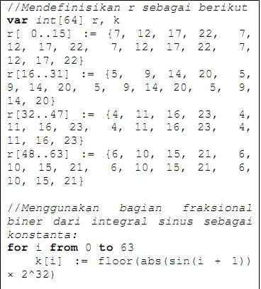
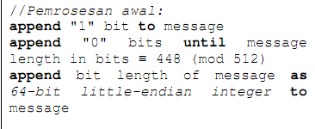
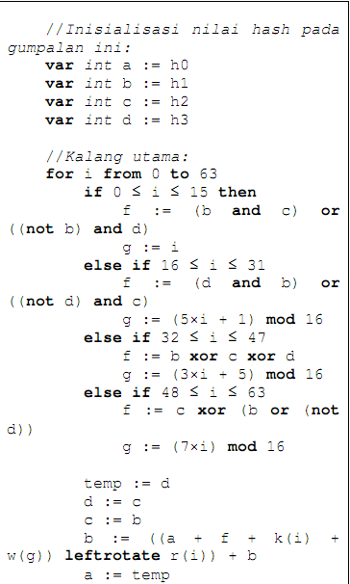
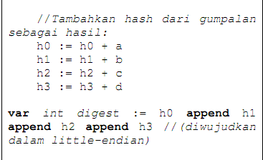
MD5 Pseudocode
Example Pseudocode for the MD5 is as follows:

Slide 23
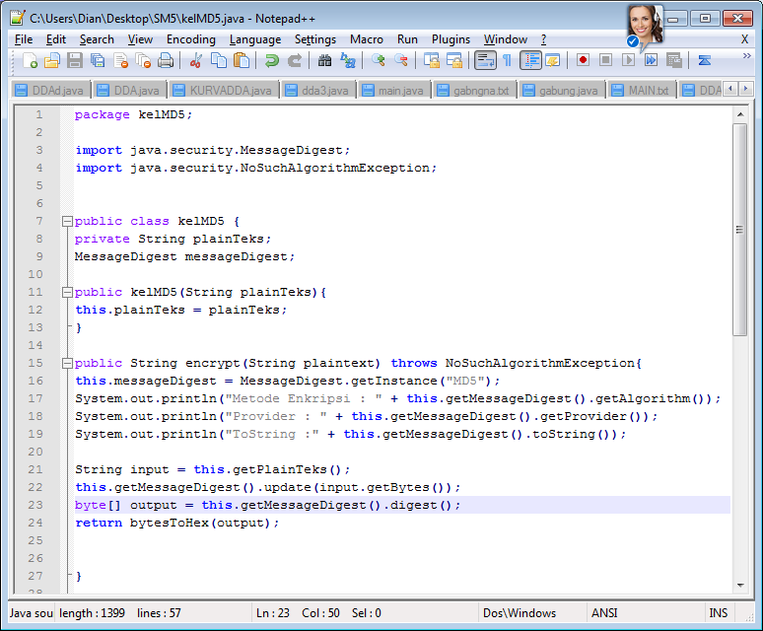
MD5 Java
Example Java Source for the MD5 is as follows:

Slide 24
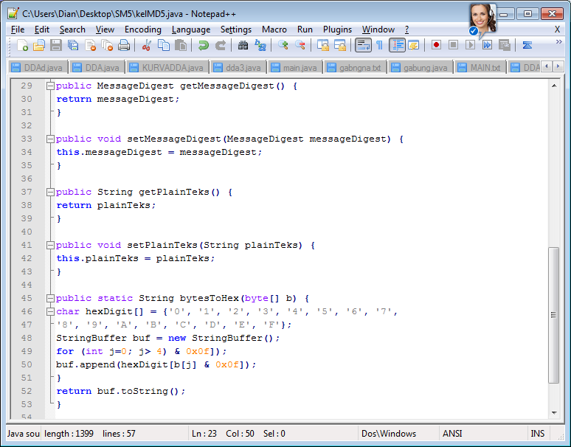
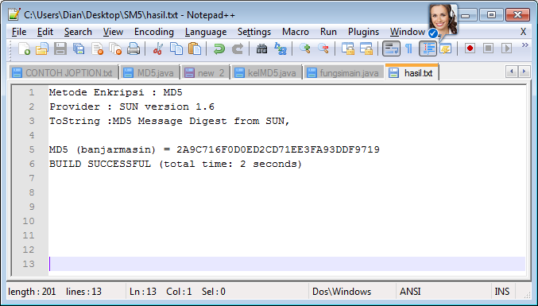
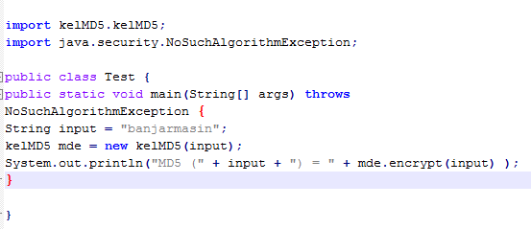
MD5 Java
Output:
Main Function:

Slide 25
Disadvantages of MD5 Algorithm
Advantages of MD5 Algorithm
Utilizes a Fast Computation Algorithm
Provides Collision Resistance
Widespread Used
Provide a One Way Hash
Security Flaws and Vulnerability
Less Secure than SHA-1 Security
Slower

Slide 26
Conclusion
The MD5 message-digest algorithm is simple to implement, and provides a fingerprint or message digest of a message of arbitrary length.
Suggestion
In the use of MD5 Algorithm we must have a basic knowledge of internet, coding, and security manage. So, we will not have problems in relation interface to come. While the technology can prove to be a great asset, it could also cause harm if not understood and used properly.

Slide 27

Thanks For Your Attention...
MD5 Algorithm

